Slide 1
Moving Forward Together
January 12, 2021

Slide 2
?
Why did SRVUSD postpone moving into the hybrid/remote learning model on January 5, 2021?
We postponed for these three reasons:
Surge in COVID-19 cases, drop in ICU bed availability in the Bay Area (CC is 7.7% as of January 9, 2021), and the extended stay at home order
Our adjusted case rate is 46.6 per 100,000
Concerns by staff
Challenge by the California Teachers Association
Notes:
Our re-opening plan has been challenged by CTA. They believe we have opened under small group cohorts, which would not constitute an actual reopening. Though we disagree with this analysis, if we continued with our re-opening plan, and we were sued by CTA, a judge would rule on this matter. Our Board decided not to test this decision through the legal system at this time in light of the spiking Covid 19 numbers and other concerns that have been mentioned. The CTA letter and our responses are attached.

Slide 3
CTA Letter and District Response

Slide 4
!
We are in the midst of an infodemic.
Infodemic is a blend of "information" and "epidemic" that typically refers to a rapid and far-reaching spread of both accurate and inaccurate information.
As facts, rumors, and fears mix and disperse, it becomes difficult to learn essential information about an issue. Infodemic was coined in 2003, and has seen renewed usage in the time of COVID-19.

Slide 5
Let’s agree that COVID-19 has been divisive.
Our unified desire is to focus on our students and their learning and their well-being.
Notes:
Many stakeholders quote the different opinions about the “science” of COVID. Some make the argument that we should be back in school. Others make the argument using the same science that we should not be back at school. The challenge is that government and/or public health officials are not directing us through regulation/legislation, everything must be negotiated locally and each school board is then left to sort this out on their own. This is very problematic and is probably an additional factor to why public schools are not open in Contra Costa County.
We understand that some of our students are not doing OK in remote learning. As we move forward we will strengthen our social/emotional supports, we will determine learning loss and we will expand specialized small groups to get more students safely on campus.

Slide 6
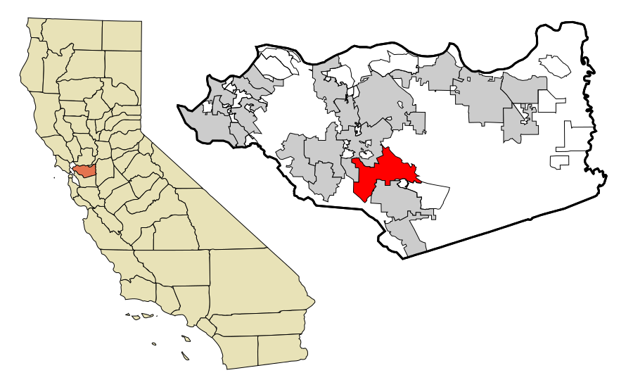
We need to focus our thinking locally.
Notes:
Although countries, and even states within our country, and even counties within our state are handling the pandemic in their own way - let’s agree that we are located in Contra Costa County and will keep our focus locally when it comes to making decisions for our district. Let’s also agree that we are a public school district and will not compare ourselves to any institution that is not a public school district within Contra Costa County.

Slide 7
?
Is SRVUSD ready to move to the hybrid/remote learning model if given the green light today?
We are completely ready.
Notes:
Clarifying chatter
We are ready to go. Everything that is happening statewide is not affecting us. We were not waiting on $ from the Governor.

Slide 8
Governor Newsom’s Safe Schools for All
Required Weekly Testing
For all students and staff
Return of TK-6 students (Hybrid)
Allows students in TK-6 grades, Special Education, English Language Learners, and other vulnerable students to school when COVID numbers fall below
28 cases per 100,000 residents.
Return of Grades 7-12
Not addressed at all in this plan
Needs Legislative Approval
We are waiting for further information and requirements from the state.
California Department of Public Health is revising guidelines.
Notes:
We are examining Governor Newsome’s “Safe Schools For All Plan”. It involves a requirement of testing all students and staff every week. It also allows students in TK-6 and students with special education needs, English language learners and other vulnerable students to return to school when the Covid numbers fall below 28 cases per 100,000 students.

Slide 9
?
Why were schedule changes necessary if we did not move into the hybrid/remote learning model on January 5, 2021?
This was a necessary step needed to ensure we are fully prepared when we move to this next step. If it hadn’t been done, a hybrid model would not be possible.

Slide 10
?
What about the elementary school waivers? Are we applying for them?
In light of the Safe Schools for All Plan, we are hearing that the waiver process no longer exists. We are waiting for clarification on this matter.

Slide 11
1
Full Remote Learning Model
No On-Campus Instruction.
We can’t control how quickly we get from step 1 to step 5, but we can be ready for each time we move between steps.
2
Full Remote Learning Model complemented with the return of specialized small-group instruction.
3
Choice of Full Remote Learning or Hybrid Model with health and safety restrictions (face coverings, social distancing, etc.)
4
If social distancing restrictions are lifted, hybrid students will return to full-time, in-person instruction.
SRVUSD REOPENS
Full-time, in-person instruction
without restrictions. Pre-COVID times.
5

Slide 12
!
As we deal with this pandemic, there are no winners.
We understand that many of our our kids need to be in school.
We understand some of our staff are anxious about returning to school.
We understand that COVID-19 numbers are at their highest.
We understand our parents have strong and different views regarding how to proceed.
We understand that union leaders may be reticent to return to school yet because they believe it is not safe.
However, we have to find creative ways to move forward in a unified way. No matter how our community is reacting to the present situation, it is important to understand these complex layers.

Slide 13
Our Commitment
SRVUSD will engage our students, collaborate with staff, and partner with our parents/guardians to determine:
How are students doing academically?
How are students doing socially and emotionally?
What do our students need right now?
How do we connect them to each other and to their campus?
Though we cannot fulfill everyone’s expectations, we will do our very best to communicate effectively and clearly throughout these challenging days so everyone is working from accurate information as we move forward.
Notes:
It is our desire to do what is best for all of our students, staff, and community. Everyone is important.

Slide 14
Vaccinations
The San Ramon Valley Unified School District will pursue opportunities to vaccinate our staff when they become available.

Slide 15
Our Remote Learning Priorities
Addressing Student Needs
Learning Loss
Social-Emotional Learning
Student/Staff Well-Being
Learning Hubs
Athletics
Expanding Specialized Small-Group Instruction to safely bring more kids onto campuses
Notes:
We understand not everyone is ok. Here is what we are doing to address our student’s needs while we are in the purple tier.

Slide 16
Social Emotional Health
and Learning Loss Data/Intervention
Presented by: Educational Services

Slide 17
Current Circumstances
Students not experiencing “normal” school: Remote since March, 2020
Need more structured opportunities and connections for social-emotional and academic support.
Leaning in and supporting students:
How can we further help students?
How have the changes to their academic and social experiences impacted them? What can we do?
What do we do for kids who don’t have layers of support?
How do we enhance supports in our current setting ?

Slide 18
?
What questions are we asking to understand student Social Emotional Health and Learning Loss Intervention?
What outcomes do we want for our students?
What does our data tell us?
What actions are we recommending?
How will we monitor students’ health and success?

Slide 19
?
What social emotional outcomes do we want for our students?
Physically and mentally healthy students
Adult connections
Consistent tracking of students’ social emotional health and wellbeing

Slide 20
 | All (5) High Schools Combined August 2019-June 2020 | All (5) High Schools Combined August 2020-January 2021
School Counseling and Intervention Program (SCIP) | 75 students participating | 43 students participating
Social Worker Referrals | 67 referrals | 48 referrals
Crisis Intervention CPS + Risk Assessments | 73 students | 28 students
Wellness Centers: California High and Dougherty Valley High | N/A | California High: 752 views, 229 referrals DVHS: 1226 views, 103 referrals
*Data compares full 2019-2020 school year to first semester 2020-2021
HIGH SCHOOL - What does our Social Emotional Health data tell us?

Slide 21
 | All (8) Middle Schools Combined August 2019-June 2020 | All (8) Middle Schools Combined August 2020-January, 2021
School Counseling and Intervention Program (SCIP) | 66 participated | 45 students participating
Social Worker Referrals | 42 social worker referrals | 38 social worker referrals
Crisis Intervention: CPS + Risk Assessments | 102 student/adult supported intervention | 76 student/adult supported intervention
*Data compares full 2019-2020 school year to first semester 2020-2021
MIDDLE SCHOOL - What does our Social Emotional Health data tell us?

Slide 22
 | All (22) Elementary Schools August 2019-June 2020 | All (22) Elementary Schools August 2020-January 2021
Rainbow Room Participation | 1,164 students participated | 432 students participate
Social Worker Referrals | 51 students referred | 38 students referred
School Counseling and Intervention Program (SCIP) Regular Mental Health Support | 300 Students | 171 students
Crisis Intervention: CPS + Risk Assessments | 90 students | 20 students
*Data compares full 2019-2020 school year to first semester 2020-2021
ELEMENTARY - What does our Social Emotional Health data tell us?

Slide 23
?
What does our Social Emotional Health data tell us?
Some students are accessing resources
Importance of staff and student connections
The challenge of connecting struggling students with appropriate resources

Slide 24
Social Emotional Health Actions: January 2021
Students | Families | Staff
All SRVUSD students will take a wellness check survey | Mental Health and Wellness Resources shared on SRVUSD and school site websites | Professional development regarding reinforcing student connections
Additional group workshops and counseling groups to address anxiety and stress |  | District Collaborative Teams
What actions are needed to support Social Emotional Health?

Slide 25
Social Emotional Health Actions: February 2021
Students | Families | Staff
Secondary and Elementary virtual Wellness Days for both remote and hybrid students | Workshops regarding addressing student stress, depression, and anxiety | SEL Staff training series
Continue Districtwide wellness check-in surveys |  | Opportunities for staff mindfulness activities
What actions are needed to support Social Emotional Health?

Slide 26
?
How will we monitor Social Emotional Health long-term?
Districtwide LCAP presentation - Revisiting Resources in the LCAP
Surveys of all SRVUSD students around well-being
Consistent tracking of SEH data throughout SRVUSD

Slide 27
?
What are the District’s Learning Loss Intervention outcomes?
Ensure every student is at grade level standard, regardless of learning environment
Continue support for site specific interventions
systemwide
Response to intervention supports

Slide 28
Learning Loss: Secondary Grade Data
 | 19-20 D/F Semester One Data | 20-21 D/F Semester One Data
All High Schools ELA Core Classes 8,942 students All Math Classes 8,140 students | ELA (D) 319 ELA (F) 139 Math (D) 562 Math (F) 298 | ELA (D) 399 ELA (F) 311 (+55%) increase from 19-20 Math (D) 137 Math (F) 308 (-49%) decrease from 19-20
All Middle Schools ELA Core Classes 5,893 students All Math Classes 5,897 students | ELA (D) 136 ELA (F) 36 Math (D) 226 Math (F) 99 | ELA (D) 218 ELA (F) 142 (+51%) increase from 19.20 Math (D) 66 Math (F) 258 (-0.5%) decrease from 19-20
Notes:
Inconsistencies in grade data strongly points to the need for the professional development we’ll be doing around grading and assessment

Slide 29
What is Universal Screening?
What does it do?
Universal Screening allows consistent assessment of every student in our District.
FastBridge and Educational Software for Guiding Instruction (ESGI)
Identifies needs of students individually by individual standards
Assists in identifying students for skill-based, small group interventions

Slide 30
What does the data tell us?
FastBridge Elementary Screener Data
 | Fall Reading Screener | Winter Reading Screener |  | Fall Math Screener | Winter Math Screener
Grade 1 Early Reading 1,325 first graders | 24% at risk | 22% at risk | Grade 1 Early Math 1,285 first graders | 19% at risk | 21% at risk
Grades 2-5 Reading 7,387 2-5 students | 19% at risk | 21% at risk | Grades 2-5 Math 7,174 2-5 students | 12% at risk | 9% at risk

Slide 31
What does the data tell us?
FastBridge Universal Screening Data: Secondary
 | Fall Reading Screener | Winter Reading Screener
ELA: | All Core Classes 6-8: at risk 18.2% 9-12: at risk 10.8% | To Be Administered in January 2021 - through grade 10
Math: | All Math Classes 6-8: at risk 10.4% 9-12: at risk 7.5% | To Be Administered in January 2021 - through Algebra 2

Slide 32
What does the District’s Learning Loss Data tell us?
Elementary:
Slight increases in students at risk in Reading in Grades 2-5 and in Math in Grade 1.
Decrease in students at risk in Math Grades 2-5
Secondary:
The secondary D/F data indicates the focus on “work completion” in a remote setting.
Inconsistencies in grade data reinforce the need for assessment reform to be delivered during Spring 2021.

Slide 33
What actions are needed to support students with learning loss?
Learning Loss Intervention Actions January 2021
Students will have access to: | Staff will have access to:
Extended student support time after school Specialized small groups during school and after school Student support time interventions based on universal screening data | Universal screening data Increased Professional Development

Slide 34
What actions are needed to support students with learning loss?
Learning Loss Intervention Actions: February 2021
Students | Staff
High School tutoring Identified students to receive in-person support and supervision with remote learning Targeted small group interventions including Student Support Time and specialized after school small groups | Universal Screening data to identify students in need of intervention Continued professional development for both remote and hybrid teaching Site Based learning teams to support effective RTI strategies Professional Development on effective grading

Slide 35
How will we monitor Learning Loss?
Systemized Response to Intervention (RTI):
Implement Interventions
Provided tiered support in a timely manner
Summer School available to students in need of remediation
Intervention time and sections
Extended student support time
Continued professional development opportunities
Continued use of universal screening tool to monitor progress over time
Grading reform efforts

Slide 36
Recommendation to our Board of Trustees
That the Board approves staff’s recommendation to continue reviewing ways to bring students back to campus for hybrid in-person instruction and specialized small groups aligned with all state and county requirements.
A status report will be brought to the next Board meeting on January 26, 2021.

Slide 37
Concluding Remarks

